Slide 1


Slide 2

Hate Speech Detection Using Machine Learning Algorithms
By
Sharjeel Arshad
&
Awais Khan
BSCS
Session-2020-24
Supervisor
Sir Almas Sheikh
University of Azad Jammu and Kashmir

Slide 3
Outlines
Introduction
History
Motivation
Objectives of the study
Existing Methods
Proposed Methods
Materials and Methods

Slide 4
Introduction
Today, the world of the internet and social media provides a platform where people freely express their opinions and thoughts in text form.
But some people used their freedom in the wrong way to direct hate towards individuals for race, religion and many more things.
Hate speech poses a significant challenge on popular social media platforms such as Twitter and Facebook, with many posts containing hateful content often originating from individuals with strong political

Slide 5
What is Hate Speech?
Any speech that promotes violence, discrimination, or hostility towards individuals or groups based on attributes such as race, religion, gender, etc.
Hate speech is defined as any speech, act, behavior, writing, or display that may cause violence or adverse action against or by a specific individual or group or that criticism or threatens a specific individual or group because of characteristics such as race, ethnicity, religion, sexual orientation, disability, or gender.
Social media platforms like Facebook and twitter has raised concerns about emerging dubious activity such as the intensity of hate, abusive and offensive behavior among us
Notes:
.

Slide 6
Motivation
Potential of social media for spreading hate speech 30% internet penetration in pakistan (World Bank, 2016)
241 million users of Facebook alone (The Next Web Report, 2017)
136 million Indians are active social media users (Yral Report, 2016)
200 million whatsapp users in Pakistan(Mashable, 2017)

Slide 7
The Challenges in Detecting Hate Speech
Because hate speech is constantly changing and language is personal, it can be challenging to identify it. Because hate speech can appear in various ways and settings, it can be challenging to define and recognize.
Furthermore, hate speech can also be hidden and sensitive, which makes it harder to recognize using normal methods.

Slide 8
Objective
The main objective of this work is to develop an automated Machine learning based project for detecting hate speech and offensive language.
Develop a system to automatically detect hate speech in textual data.
Use machine learning algorithms to classify text into categories such as:
Hate Speech
Offensive Language
No Hate or Offensive Content
Improve accuracy using advanced natural language processing (NLP) techniques.

Slide 9
Limitations of Existing Techniques
There are many techniques used for the detection of Covid-19 but not achieve maximum accuracy, sensitivity and sparsity.
Most of them using a large number of features (Resnet101 use 2048 features) which require a huge computational time(5 to 10 days) and memory.
RT-PCR gives low Prediction rate (up to 30%).

Slide 10
Limitations of Existing Techniques
In previous studies machine learning algorithms implements handcrafted features, which are fully dependent on the type and relevance of features.
ML methods are features dependent (morphological ,texture,entropy,SIFT etc. )
These features are also correlated to each other because much complex dimensions.

Slide 11
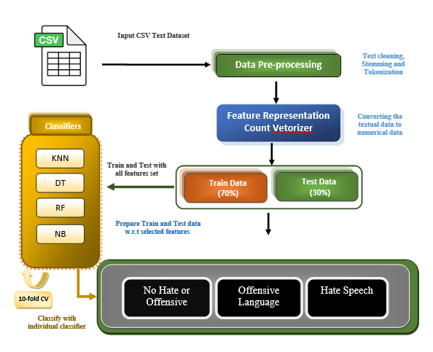
Flow Chart of proposed system

Slide 12
Materials & Methods
Data Set
Classification
Feature selection
Boruta Force Algorithm
Principal Component Analysis(PCA)

Slide 13
Dataset Description
The dataset I’m using for the hate speech detection task is downloaded from Kaggle.
This dataset was originally collected from Twitter and contains the following columns:
index
count
hate_speech
offensive_language
neither
class
tweet

Slide 14
System Workflow
Data Preprocessing
Text cleaning, vectorization, and feature extraction.
Feature Representation
Count Vectorizer.
Algorithm Selection
Naive Bayes
Support Vector Machines (SVM)
Decision Trees
Random Forest.
Model Training
Train models on labeled data.
Evaluation
Assess performance using metrics like accuracy, precision, recall, and F1-score.

Slide 15
Challenges
Ambiguity in Language
Sarcasm and irony are difficult to detect.
Context Dependency
Meaning depends on the surrounding text.
Class Imbalance
Hate speech is often a minority class.
Evolving Language
New slangs and terms emerge frequently.

Slide 16
Results
Performance Metrics:
Algorithms | Accuracy | Precision | Recall | F1 Measure
KNN | 85% | 84% | 85% | 85%
SVM | 86% | 82% | 86% | 83%
NB | 77% | 60% | 77% | 68%
DT | 89% | 88% | 89% | 88%

Slide 17
Conclusion
Machine learning algorithms are effective in detecting hate speech.
Proper preprocessing and algorithm selection are critical for success.
Continuous learning and adaptation are necessary to handle evolving challenges.
This project contributes to creating safer online communities.

Slide 18
Future Work
Improve accuracy with advanced models (e.g., Transformers).
Expand dataset for diverse languages and contexts.
Real-time deployment on social media platforms.
Incorporate multimedia content (images, videos) for comprehensive detection.

Slide 19


